Slide 1
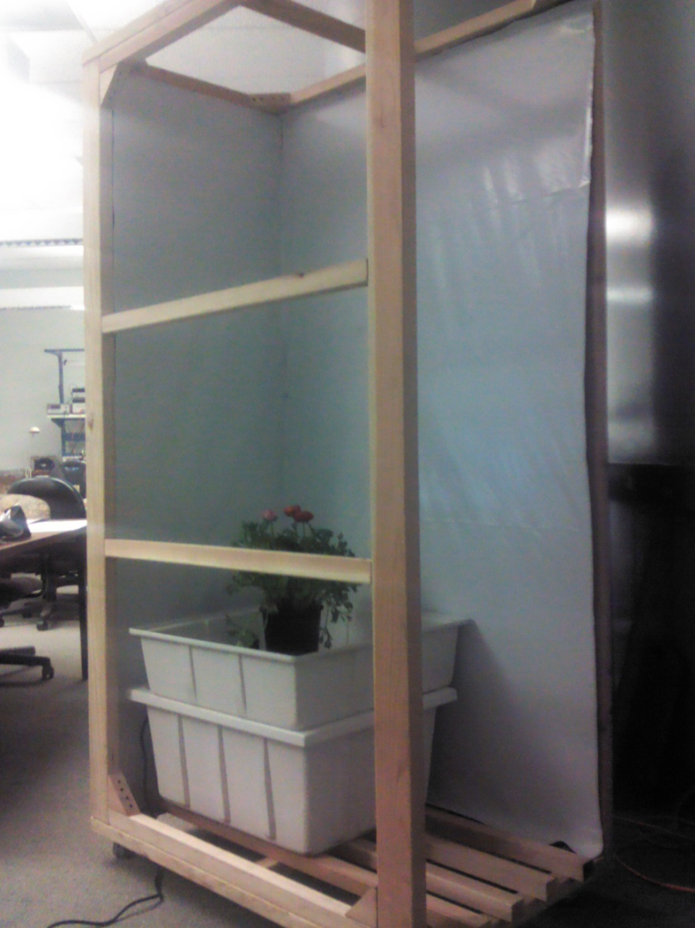
ACAMP HYDROPONIC
Justin Johnson
Stark Pister
Danny Gunny
Wayland He

Slide 2
ACAMP: What is it?
ACAMP is a self-contained, sustainable system capable of growing any plants effectively
Lighting, Temperature/Humidity, Nutrients, and pH level all automated
Environment can be monitored on website using a webcam. Data will be saved so entire growth cycle can be observed

Slide 3
Mission Statement
Automated Care And Monitoring of Plants encourages the growth of plants on a smaller scale by making hydroponics simple. We believe the automation ACAMP provides will revitalize an interest in subsistence agriculture.

Slide 4
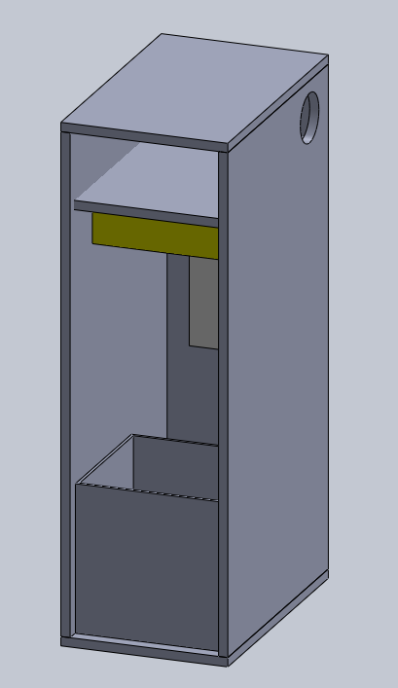
System Overview
http://www.simplyhydro.com/system.html

Slide 5
What Makes ACAMP Unique
In system digital sensors
Automated ebb and flow system
Web controlled environment
Fully programmable feeding schedules
Adjustable light system
Real time webcam monitoring

Slide 6
Minimum Specifications
Develop web interface to monitor and change the environment parameters
Make the system Internet-capable via Ethernet
System will guarantee at least one week of no human interaction

Slide 7
Physical Design
Structure intended to fit through a typical door
Redwood chosen to be environmentally durable
Panda Plastic Lining reflects 75-90% of light back to plants
Insulation keeps plants warm at night
Exhaust at top vents hot, stale air out

Slide 8
Sensors & Actuators
Atlas Scientific pH and TDS sensors
DHT22 Temperature/Humidity sensor
Relay Control
Lights, Fans, and Pumps
Solenoid release valves
Winch and pulley system

Slide 9
Microcontroller and Raspberry Pi
Raspberry Pi
Full Linux computer
Small form, low price
Ethernet capable
Simple interface
ATMega2560
256k Flash memory
4 UARTs
Ample GPIO
Well documented

Slide 10
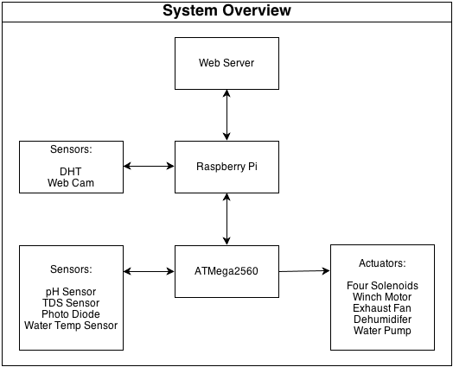
High Level System Overview

Slide 11
Division of Labor
Name | Lead | Assisting
Justin Johnson | Physical Design Gantt Chart PCB Design Web Design | Solidworks
Danny Gunny | Temp/Humidity Sensor Exhaust Fan Dehumidifier Power Supply | pH/TDS Sensors
Wayland He | Solidworks Design Webcam Processing Light Suspension | Code Supervision
Stark Pister | pH/TDS sensors Solenoid Release Valves Code Supervision | Web Design Light Suspension

Slide 12
Winter Quarter Objectives
Pump controlled by ATMega2560
Raspberry Pi communication with ATMega2560
Reading data through the ph and TDS sensors
Temperature and Humidity sensors working
Structural framework completed
Laser scanning height detection system built

Slide 13
Research Outside UCSC
Doug Au, of MBARI
Santa Cruz Hydroponic store
Steve Fambro, founder of Aptera
Hydroponic Literature – Including “Gardening Indoors”

Slide 14
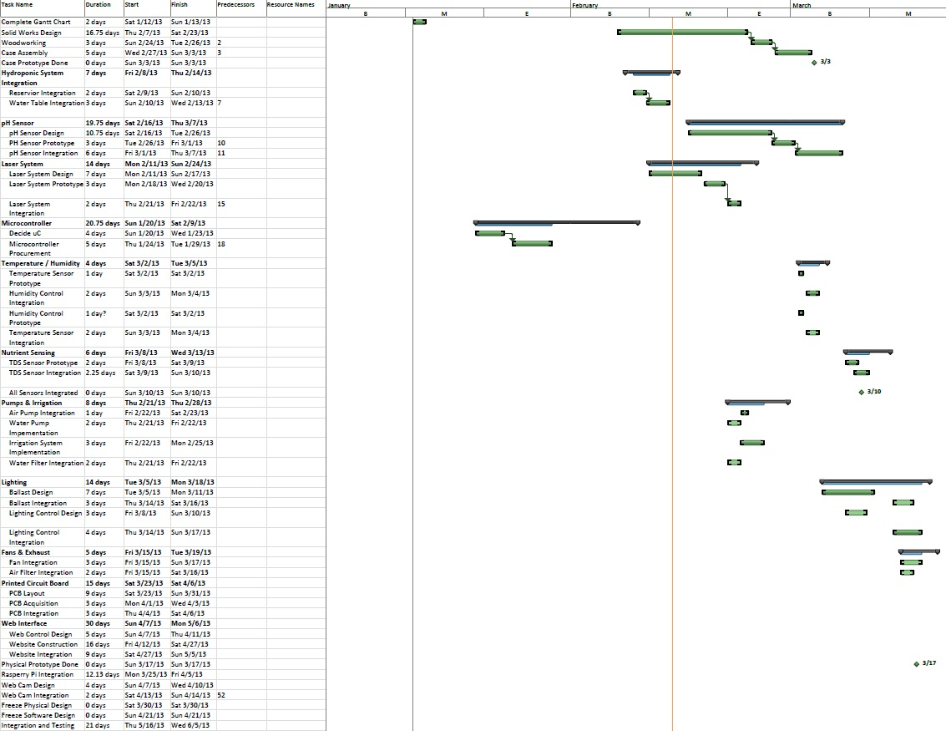
Gantt Chart

Slide 15
What Is Working and How
Timer, IO pins, and relay controlled pump
pH and TDS UART interface
Raspberry Pi and ATMega2560 USB UART connection
DHT one-wire connection to Raspberry Pi
Google Docs datasheet

Slide 16
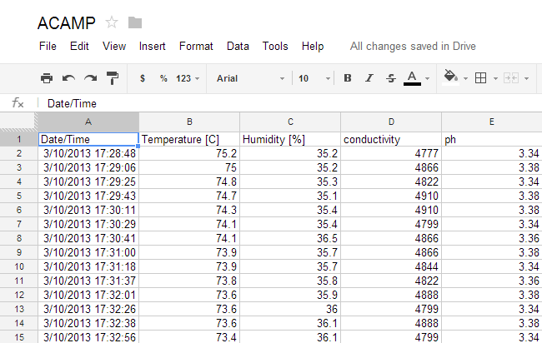
Success!
Getting all sensors to upload their values to Google Docs

Slide 17

Success!
Having the water pump turn off at the appropriate time

Slide 18
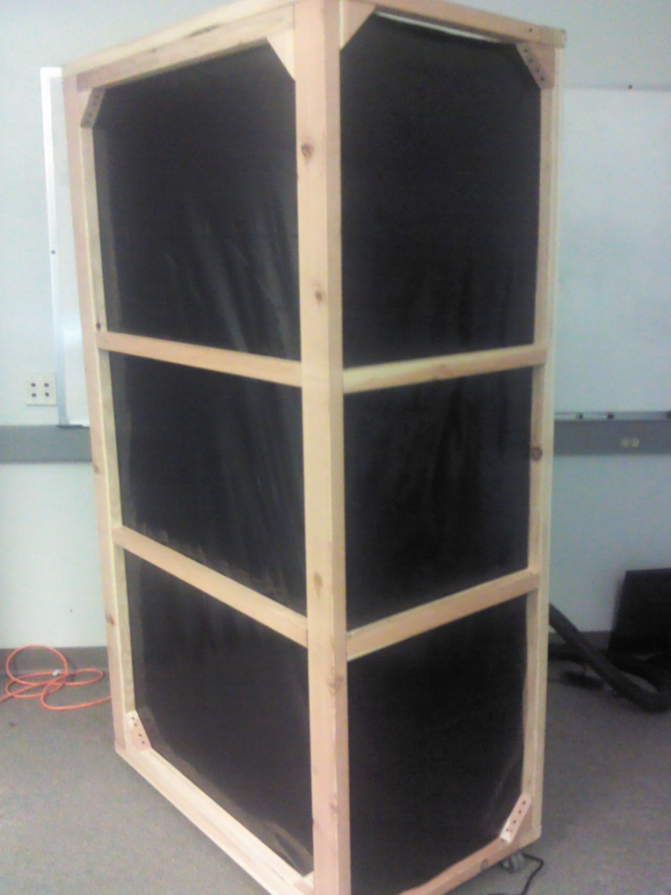
Success!
Frame and panda plastic lining

Slide 19
Our Failures…
Laser system design
Counter EMF of relay for water pump
UART carriage return

Slide 20
Budget

Slide 21
Spring Break and Onward
Solenoid valves, image processing, lights and fans over spring break
Pulley system, PCB, dehumidifier, power supply, and web interface to be developed next quarter
Framework, paneling, and insulation finished by mid-quarter

